Slide 1
Lecture 7 - Review of Probability Notations and Concepts
DS 4400: Machine Learning and Data Mining 1

Slide 2
Today
Today
Probability Functions
Joint Distributions
Marginalization
Conditional Probability
Independence
Estimating PDFs

Slide 3
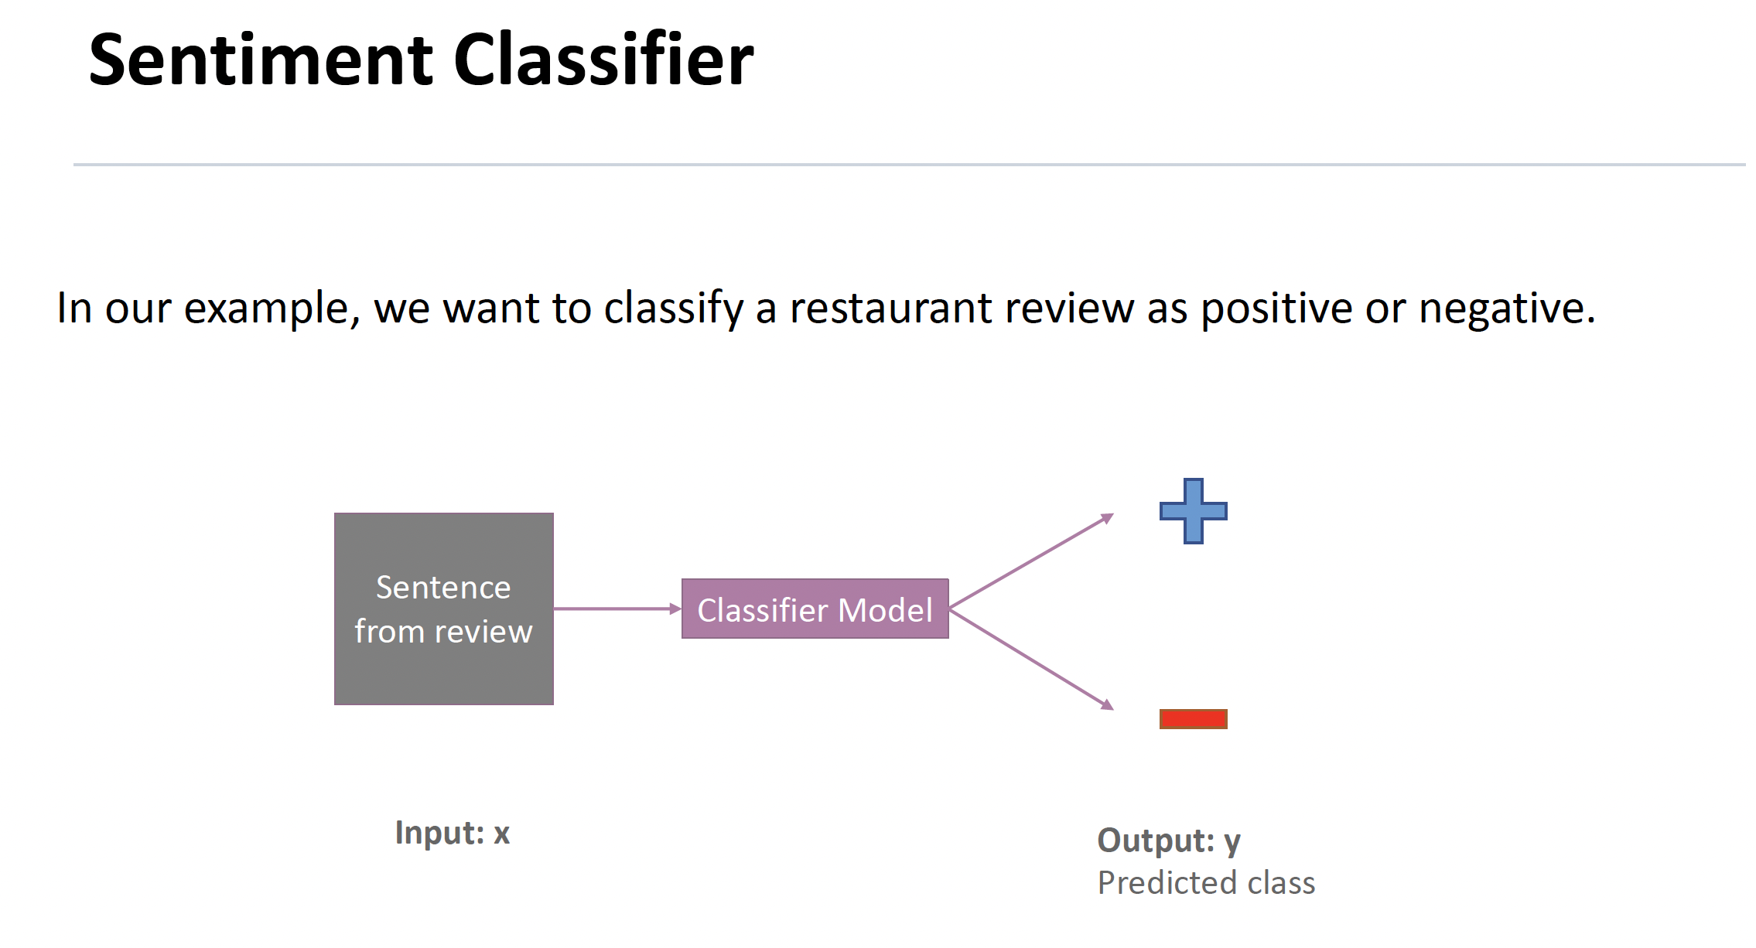
Motivation: Logistic Regression

Slide 4
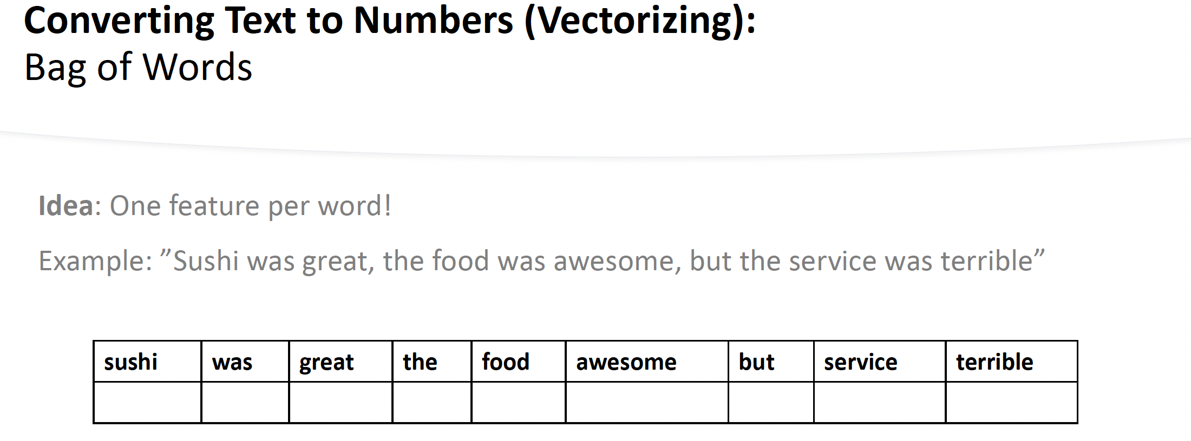

Slide 5
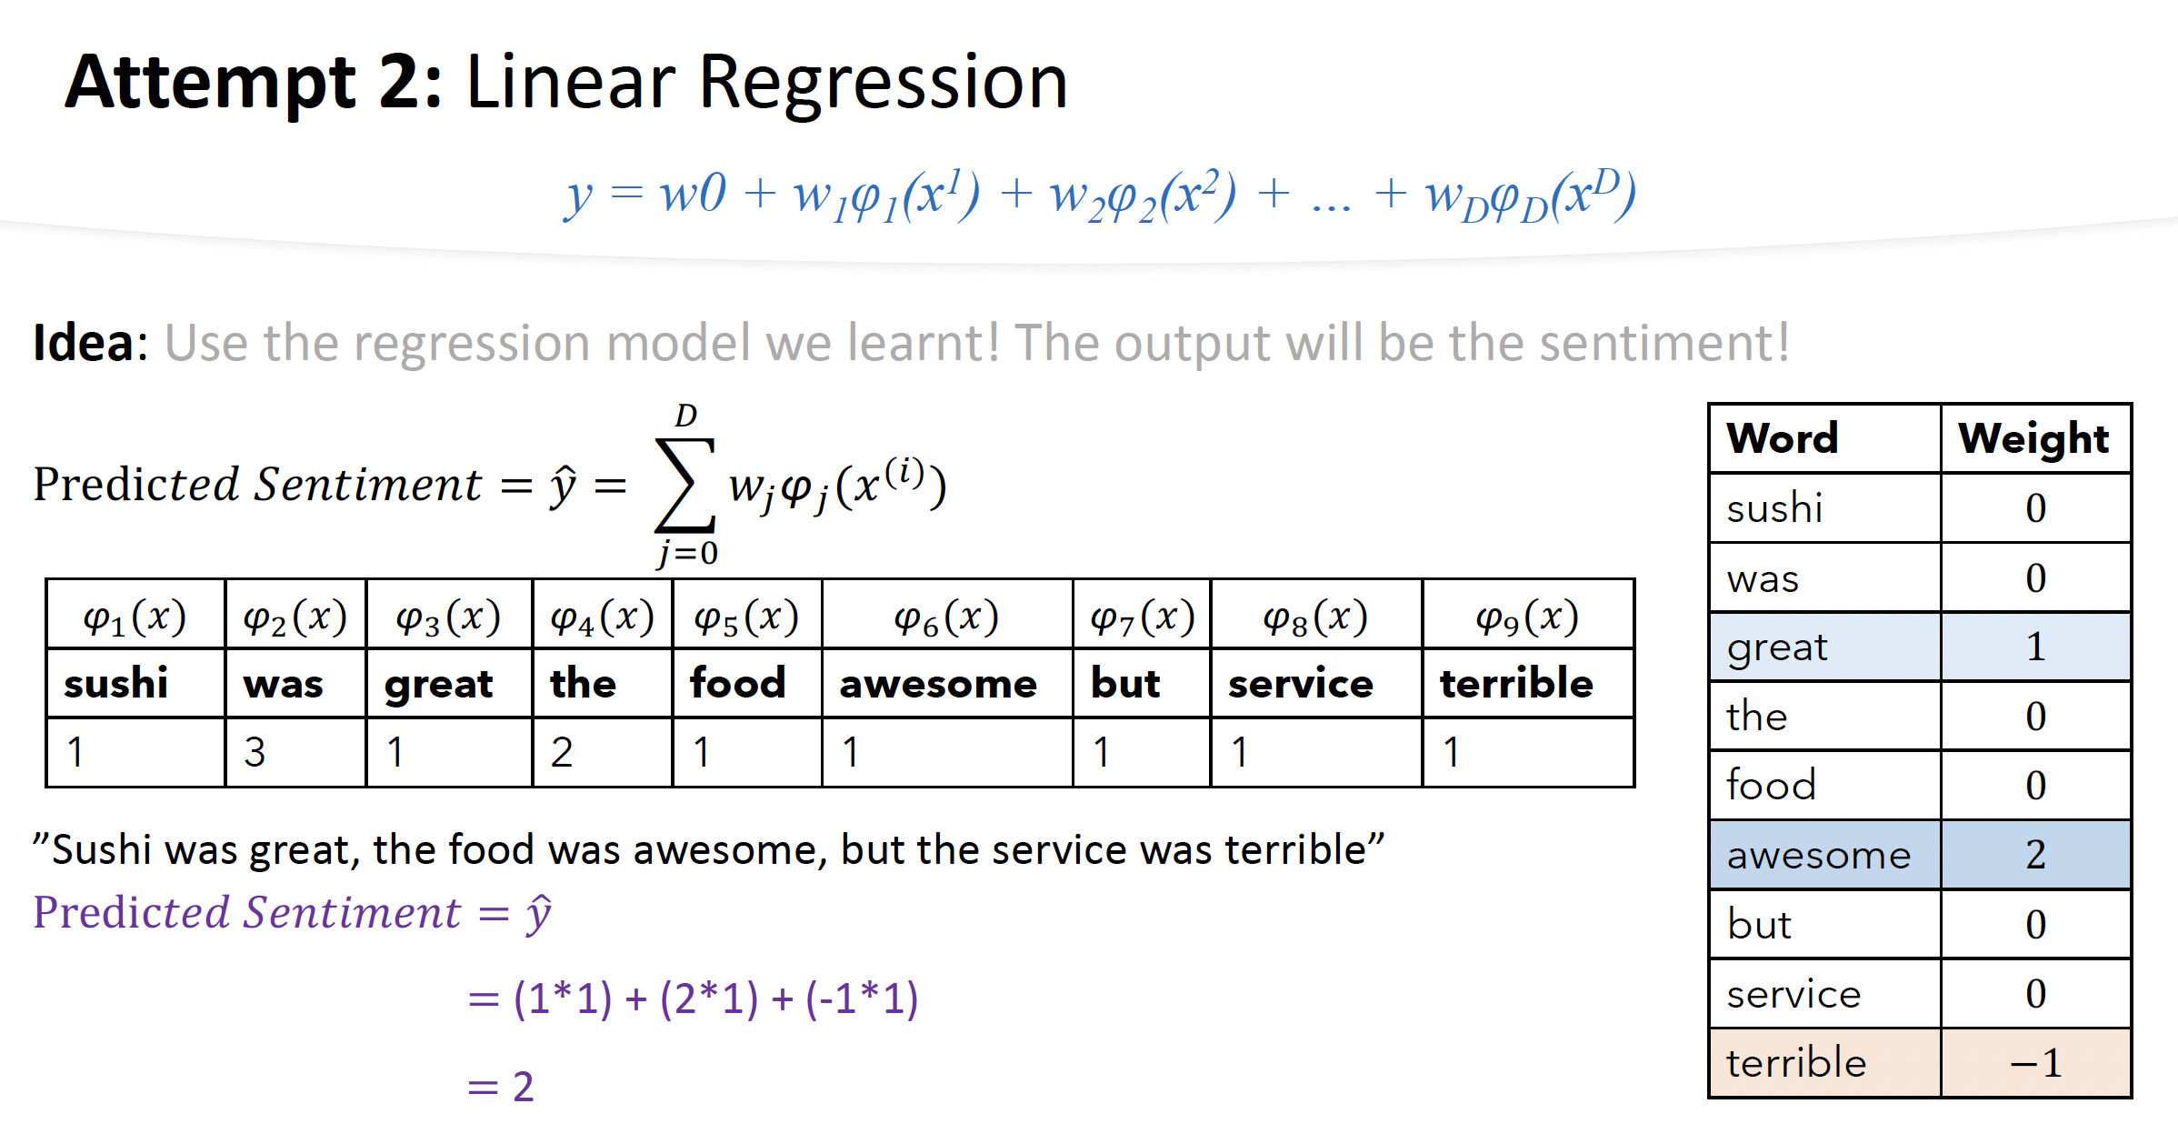

Slide 6

A few reminders about probability
The probability of an event E, denoted as P(E), is given by
n as the total number of possible outcomes.
m as the number of favorable outcomes.

Slide 7

Examples: rolling a die
What’s the probability of getting a 6 when rolling a six-sided fair die?
m = 1; n = 6; So P(E) = 1/6

Slide 8

Another example: drawing a card
What’s the probability of drawing an ace from a deck for 52 cards?
m = 4; n = 52; So P(E) = 4/52 = 1/13

Slide 9
Random Variable: what is that?
A numerical quantity whose value depends on the outcome of a random event.
Discrete Random Variable: can only take on a countable number of distinct values.
Continuous Random Variable: can take on any value within a certain range.
Random variables are denoted as X, Y, or Z, and their specific values as x, y, or z.

Slide 10


Examples of discrete random variables
The value of a single fair dice roll
The value of a card drawn from a deck of cards
The age of a randomly selected student

Slide 11
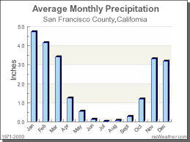

Examples of continuous random variables
Height of a person
Amount of rainfall
Speed of an object

Slide 12
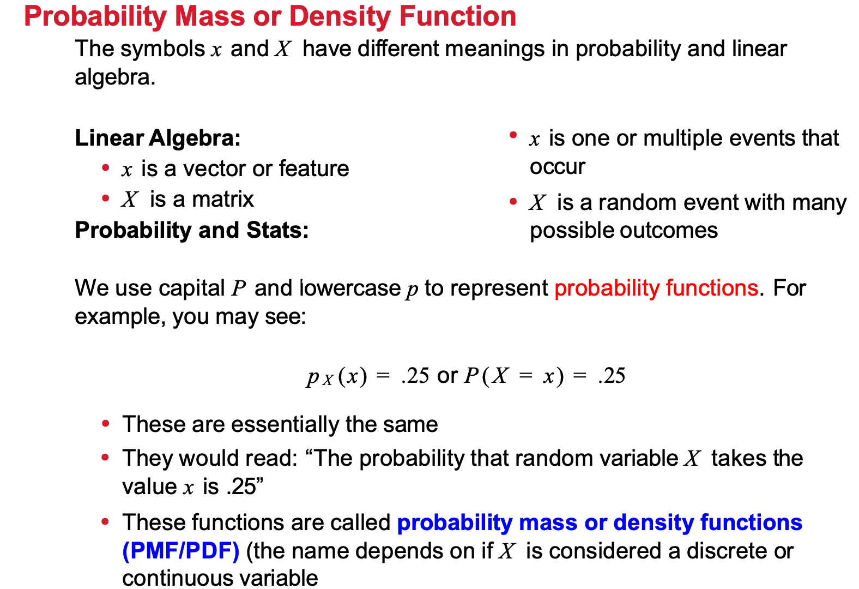

Slide 13
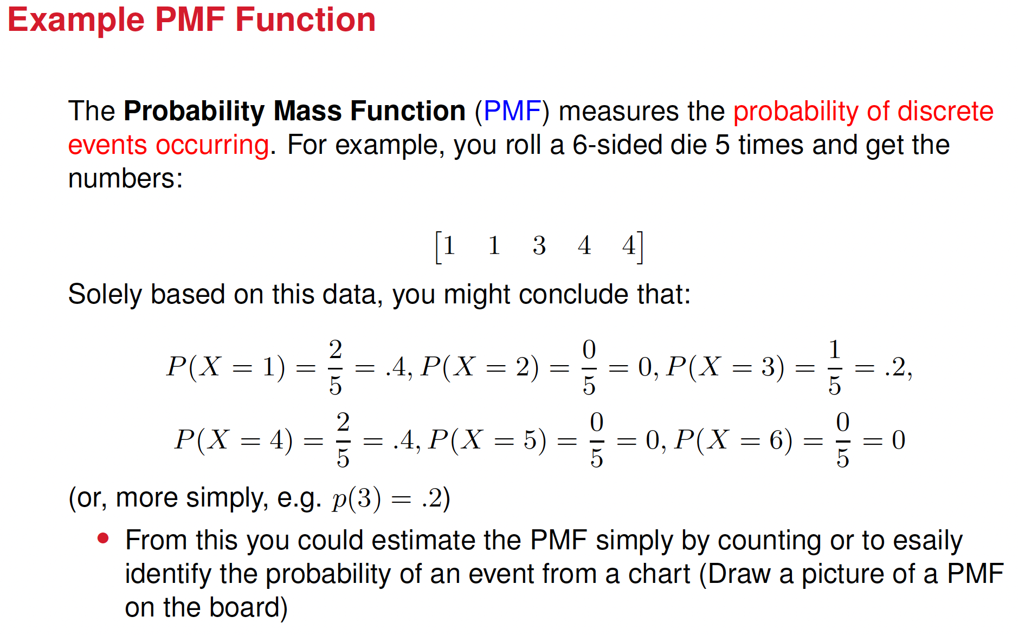

Slide 14
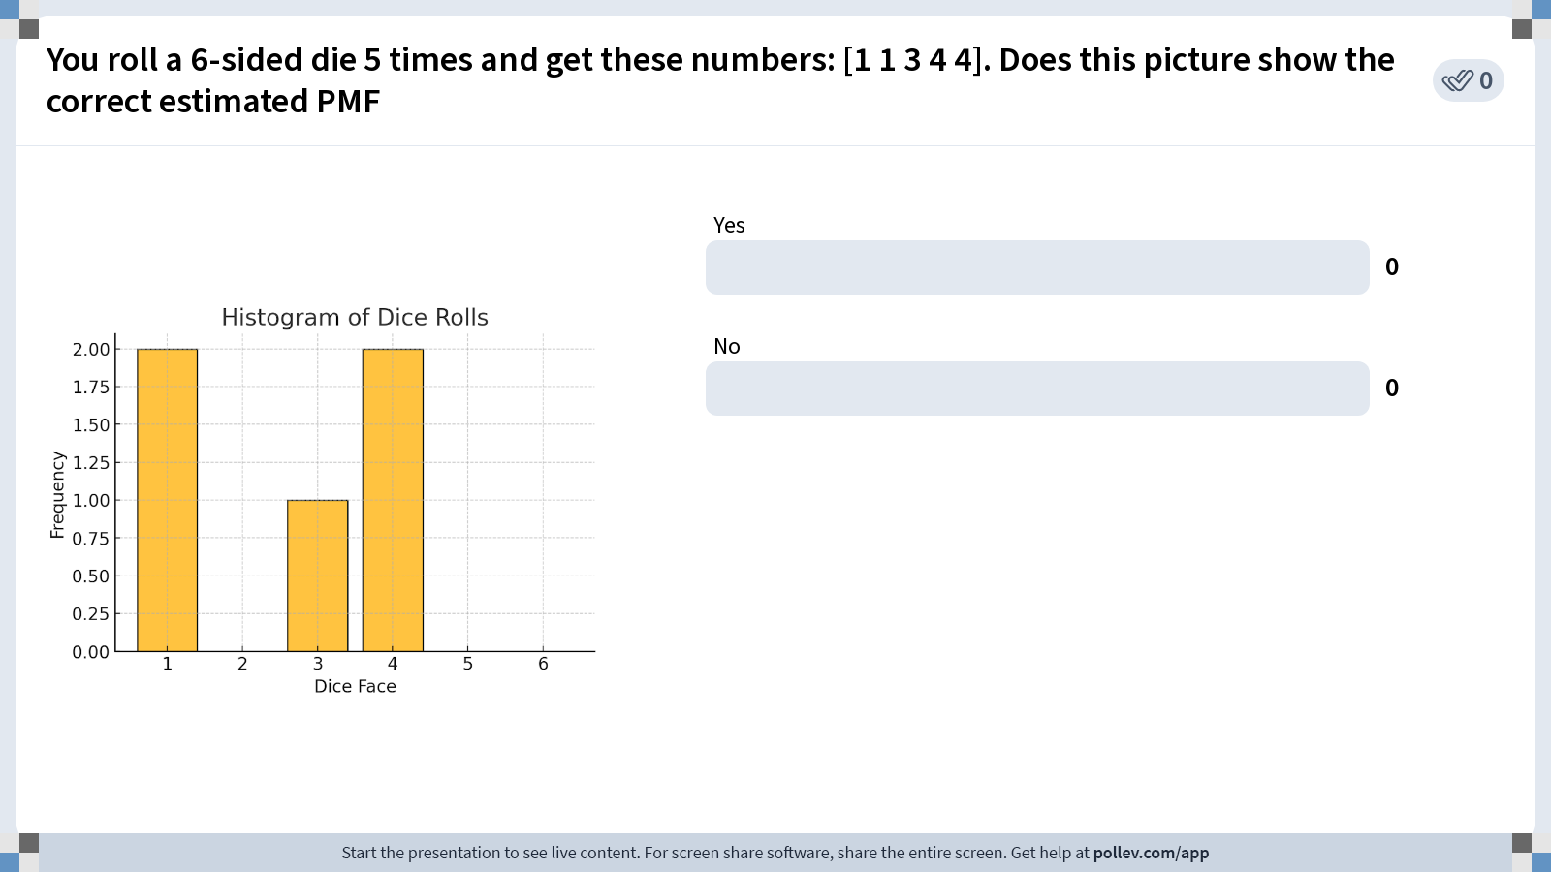
Notes:
Do not modify the notes in this section to avoid tampering with the Poll Everywhere activity. More info at polleverywhere.com/support You roll a 6-sided die 5 times and get these numbers: [1 1 3 4 4]. Does this picture show the correct estimated PMF
https://www.polleverywhere.com/multiple_choice_polls/nwetBnhkbyBoLbb0as2KI?state=opened&flow=Default&onscreen=persist

Slide 15
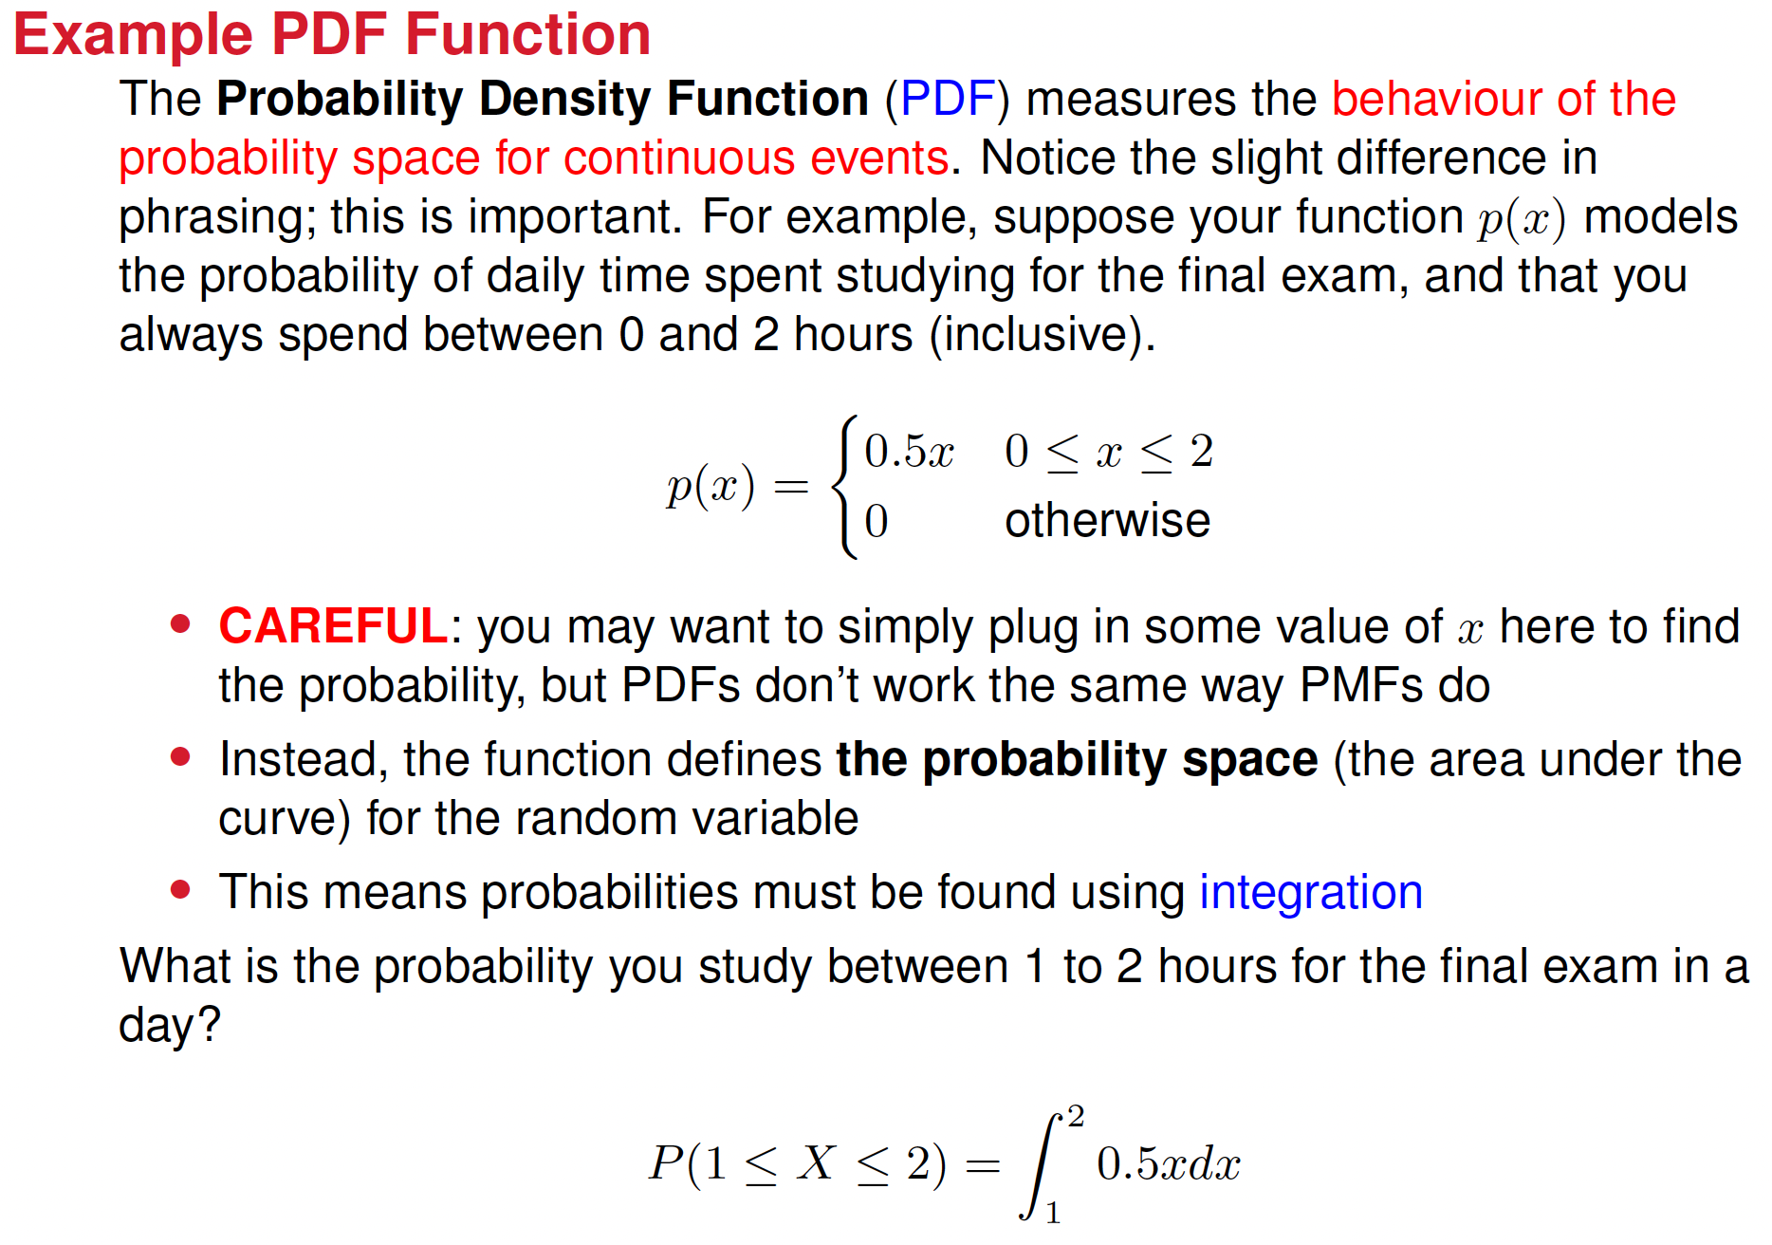

Slide 16
Probability Distribution
A mathematical function that assigns probabilities to each possible outcome of a random variable and tells how likely it is for each possible outcome to happen.
Discrete Probability Distributions: for discrete variables. Examples: Bernoulli, binomial, Poisson distributions
Continuous Probability Distributions: for continuous variables. Examples: Gaussian, exponential distributions

Slide 17
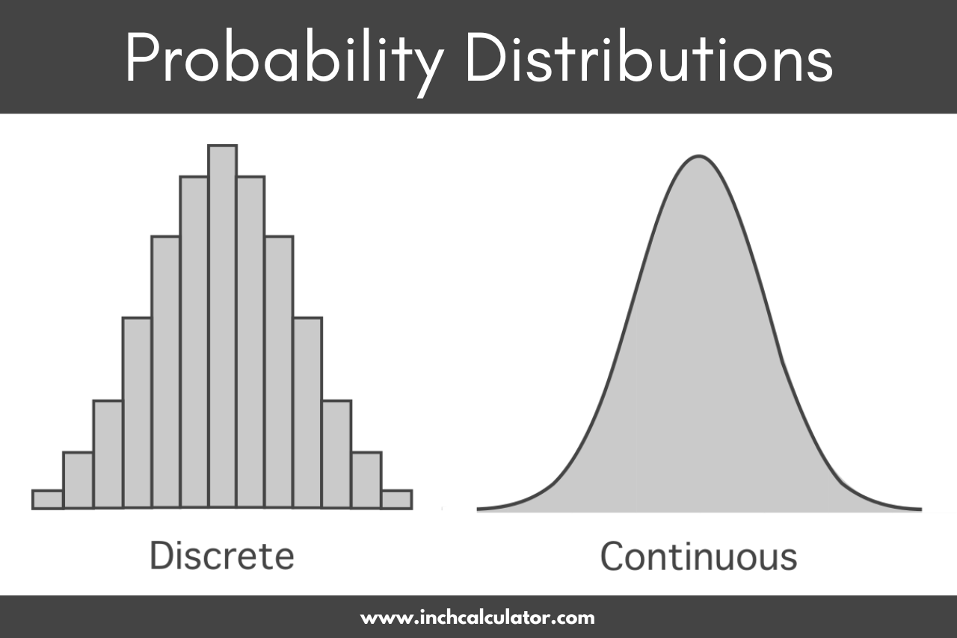















Discrete vs. Continuous Probability Distribution

Slide 18
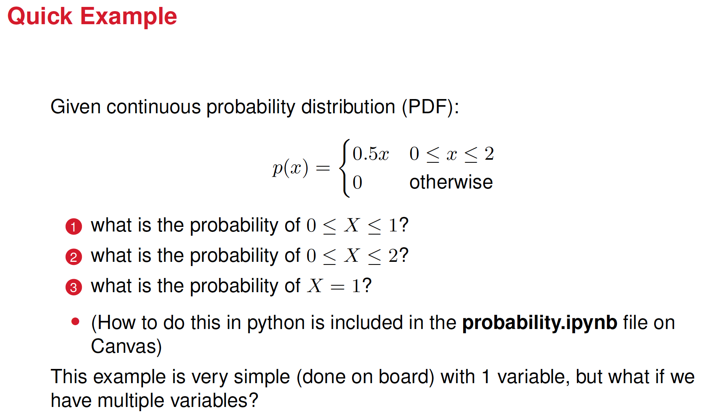

Slide 19
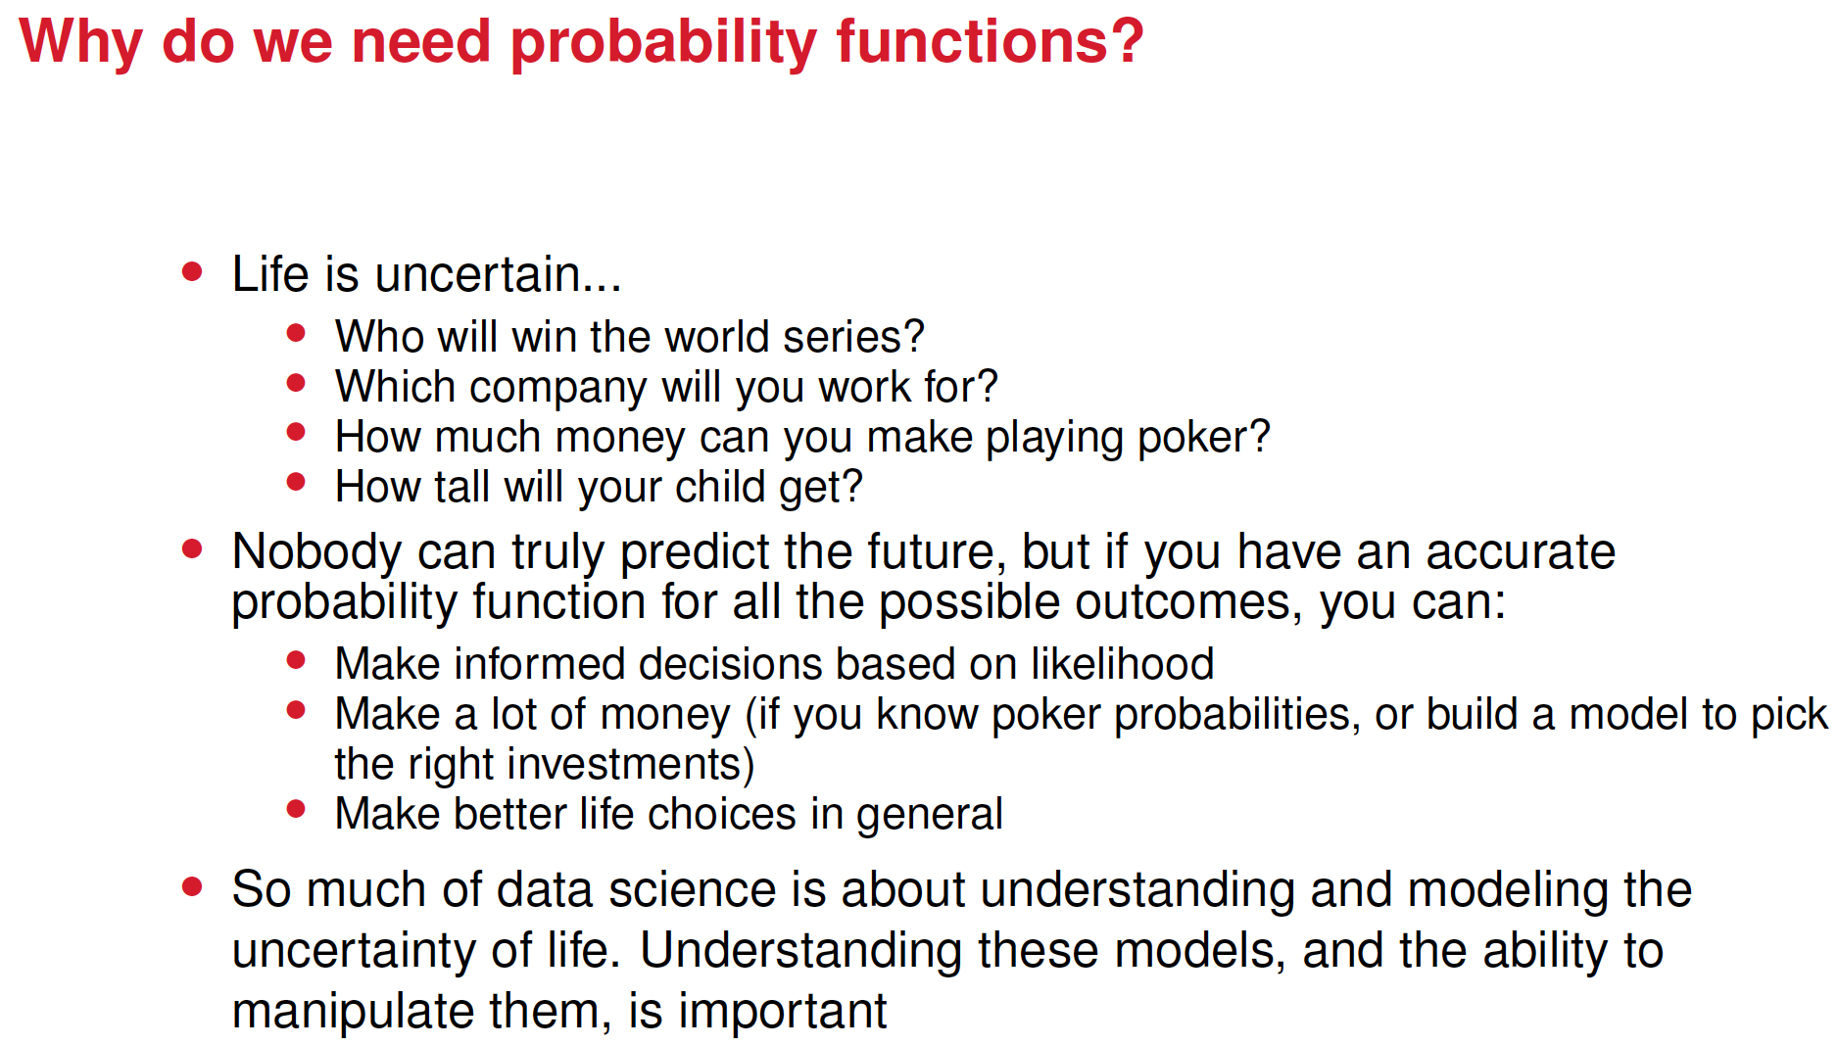

Slide 20
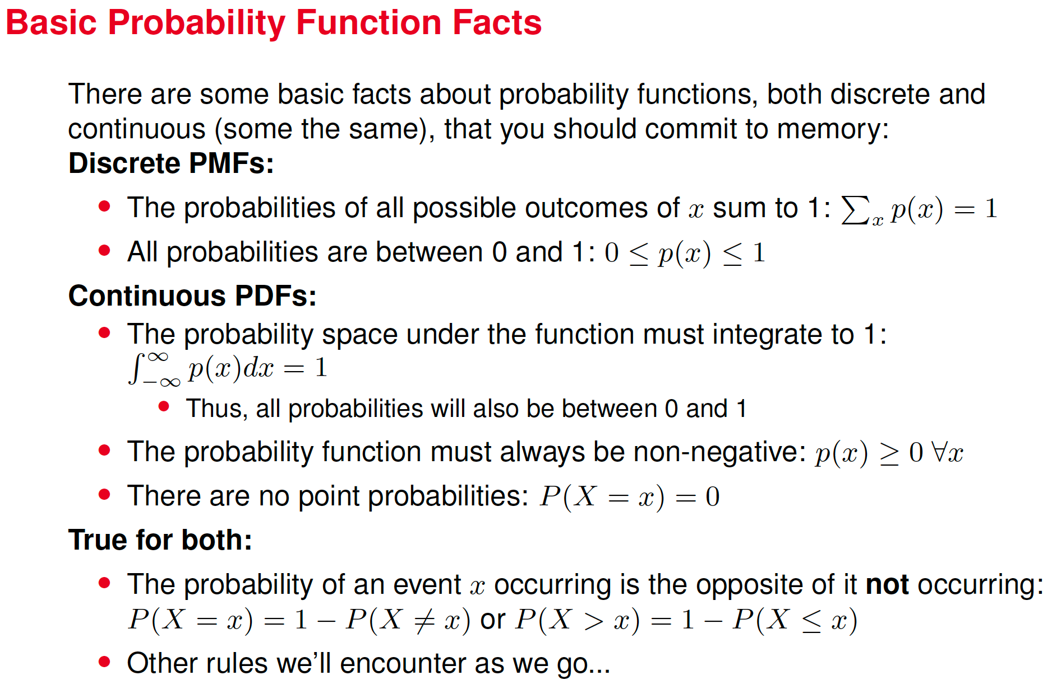

Slide 21
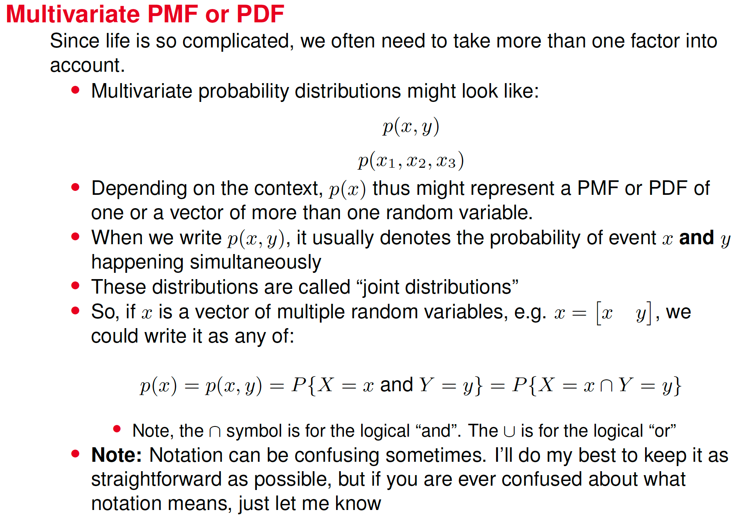




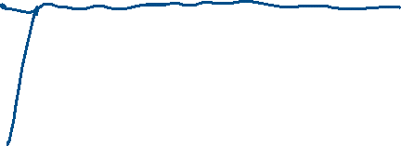




Slide 22
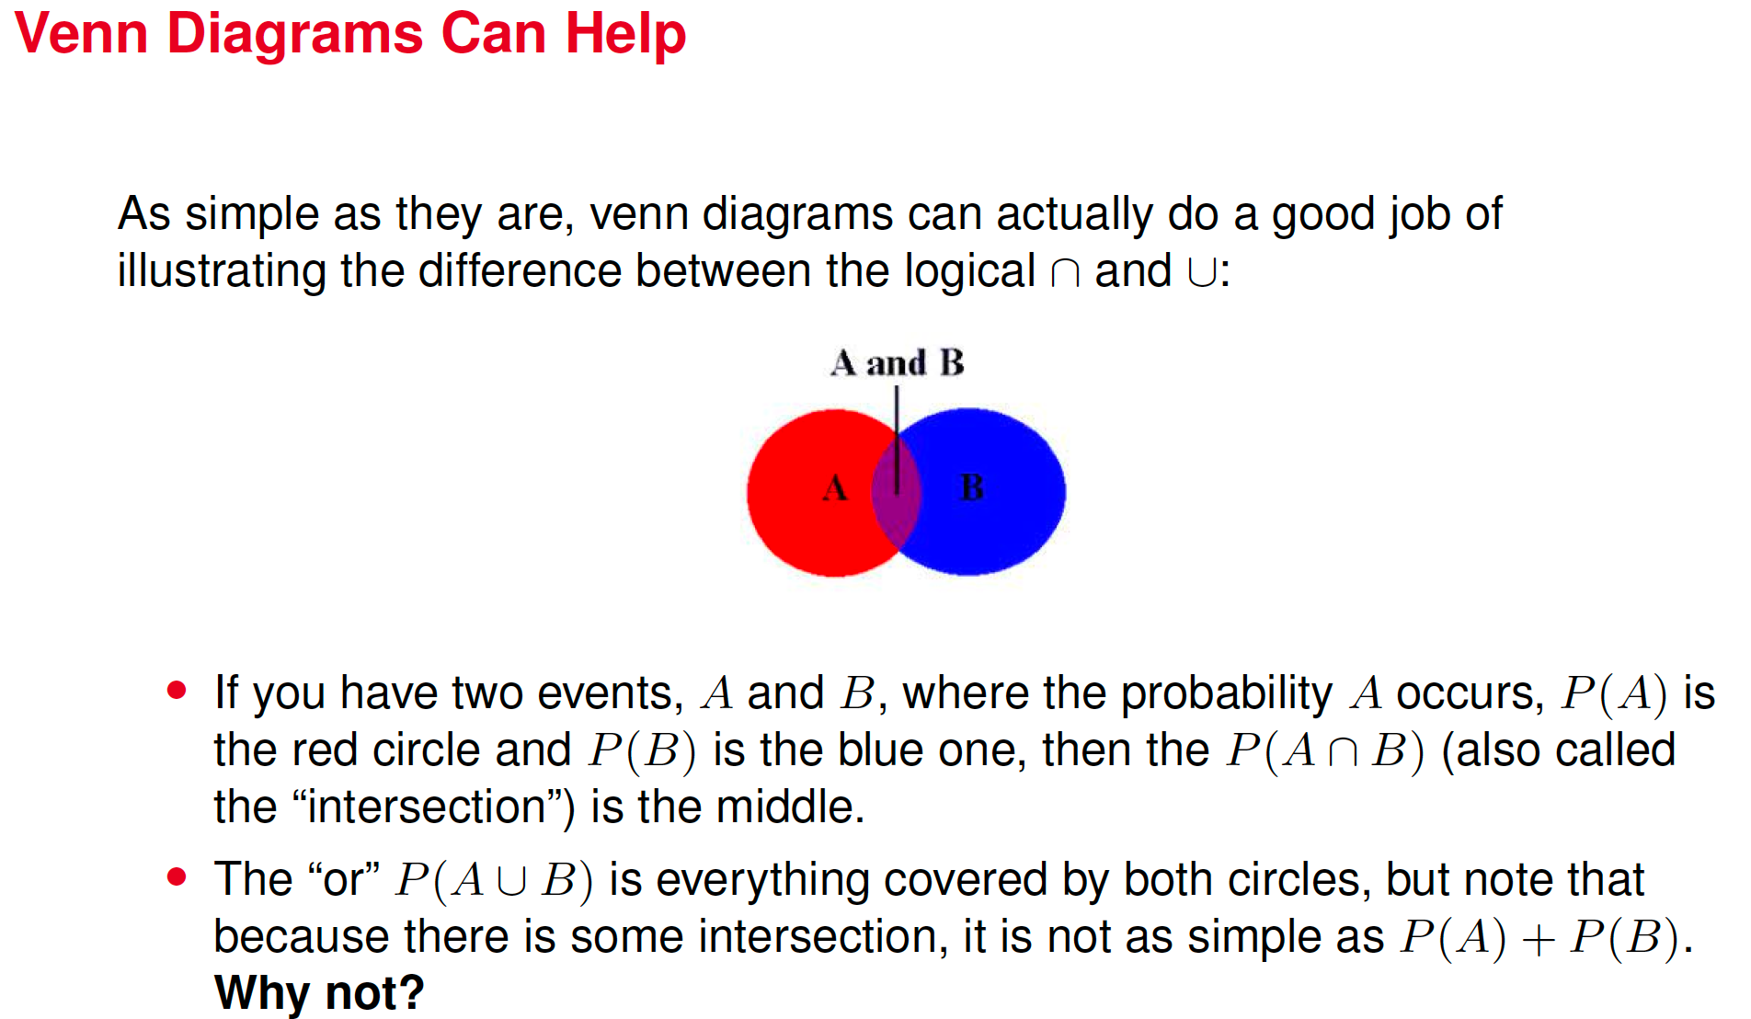


Slide 23
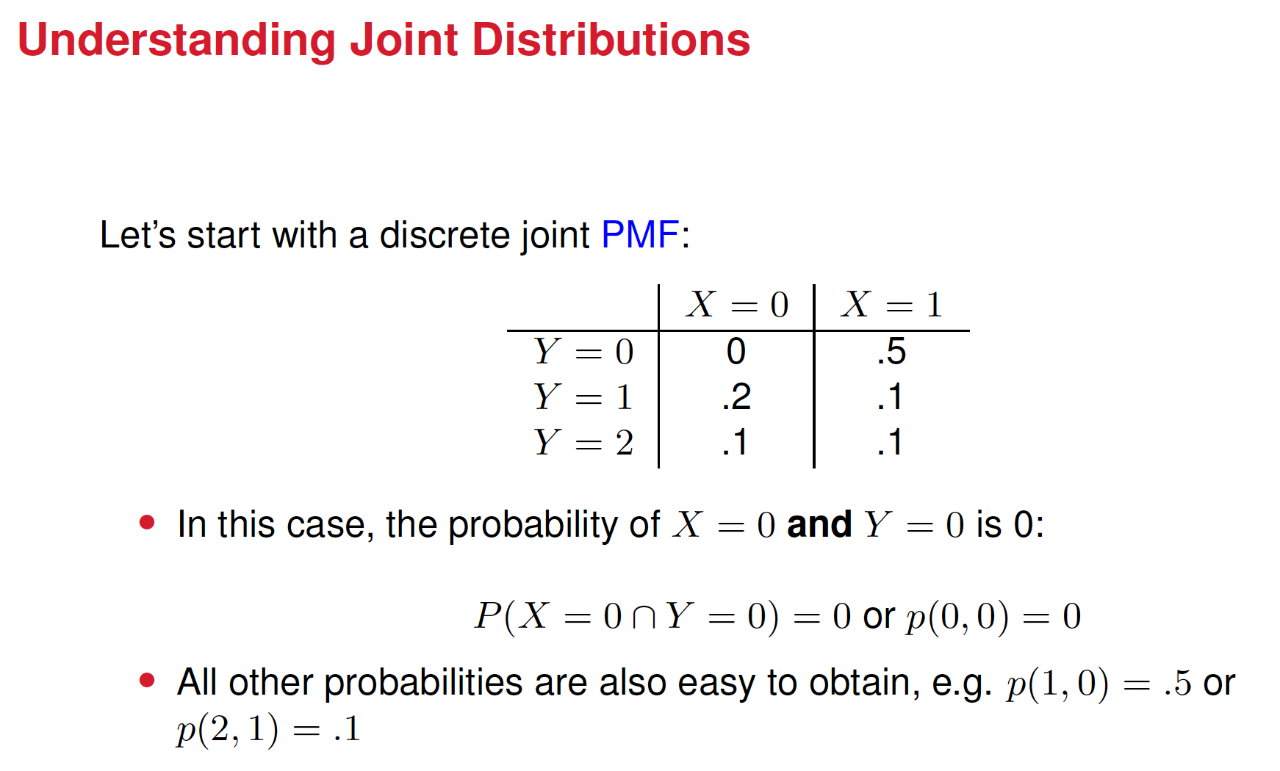

Slide 24
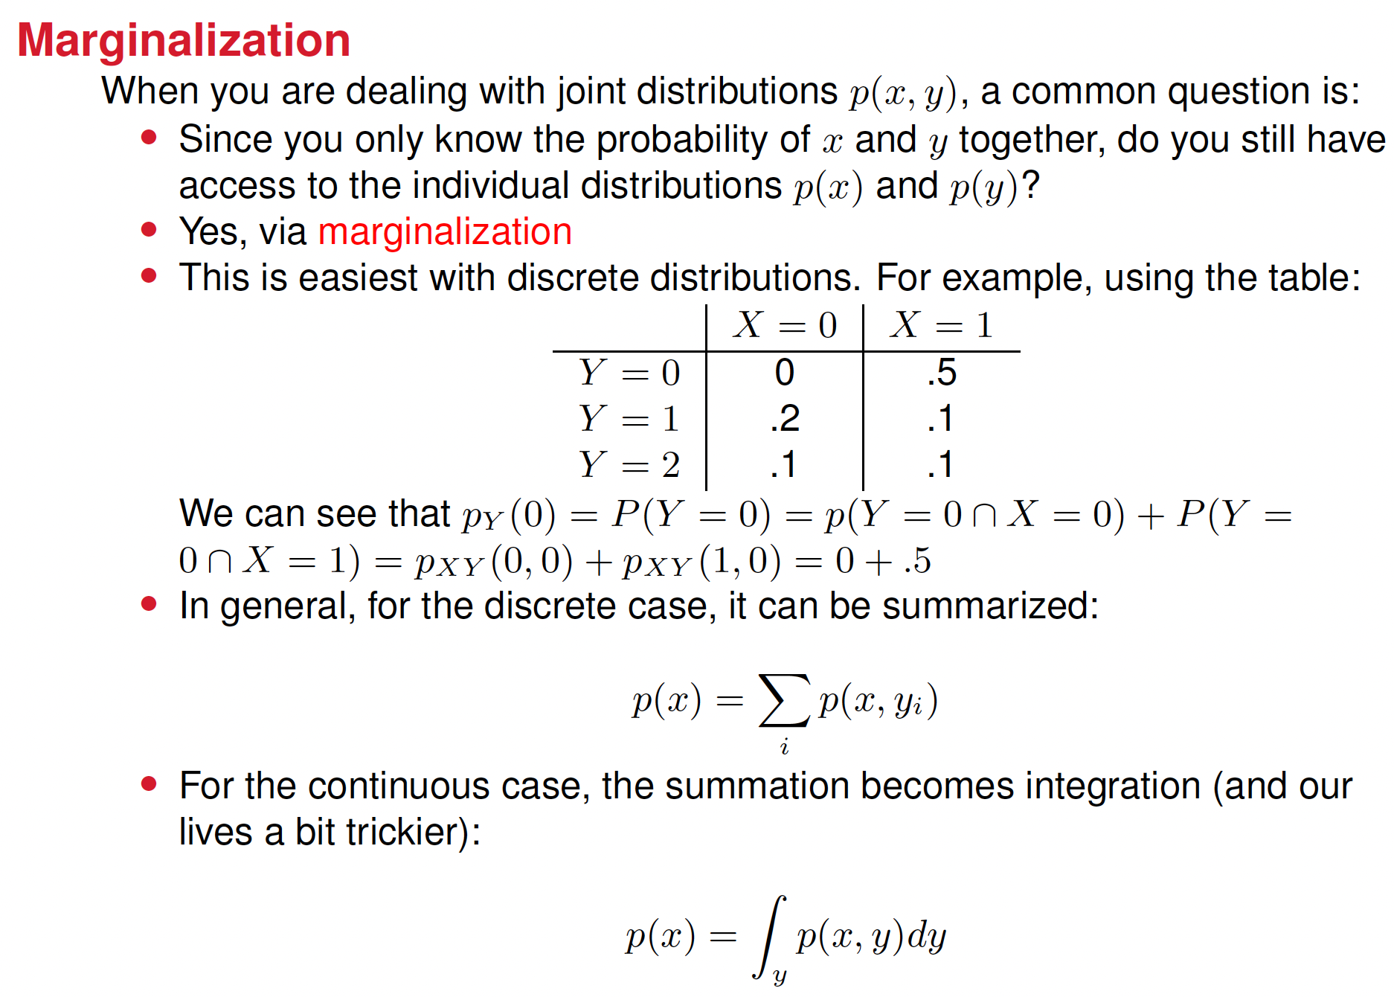

Slide 25
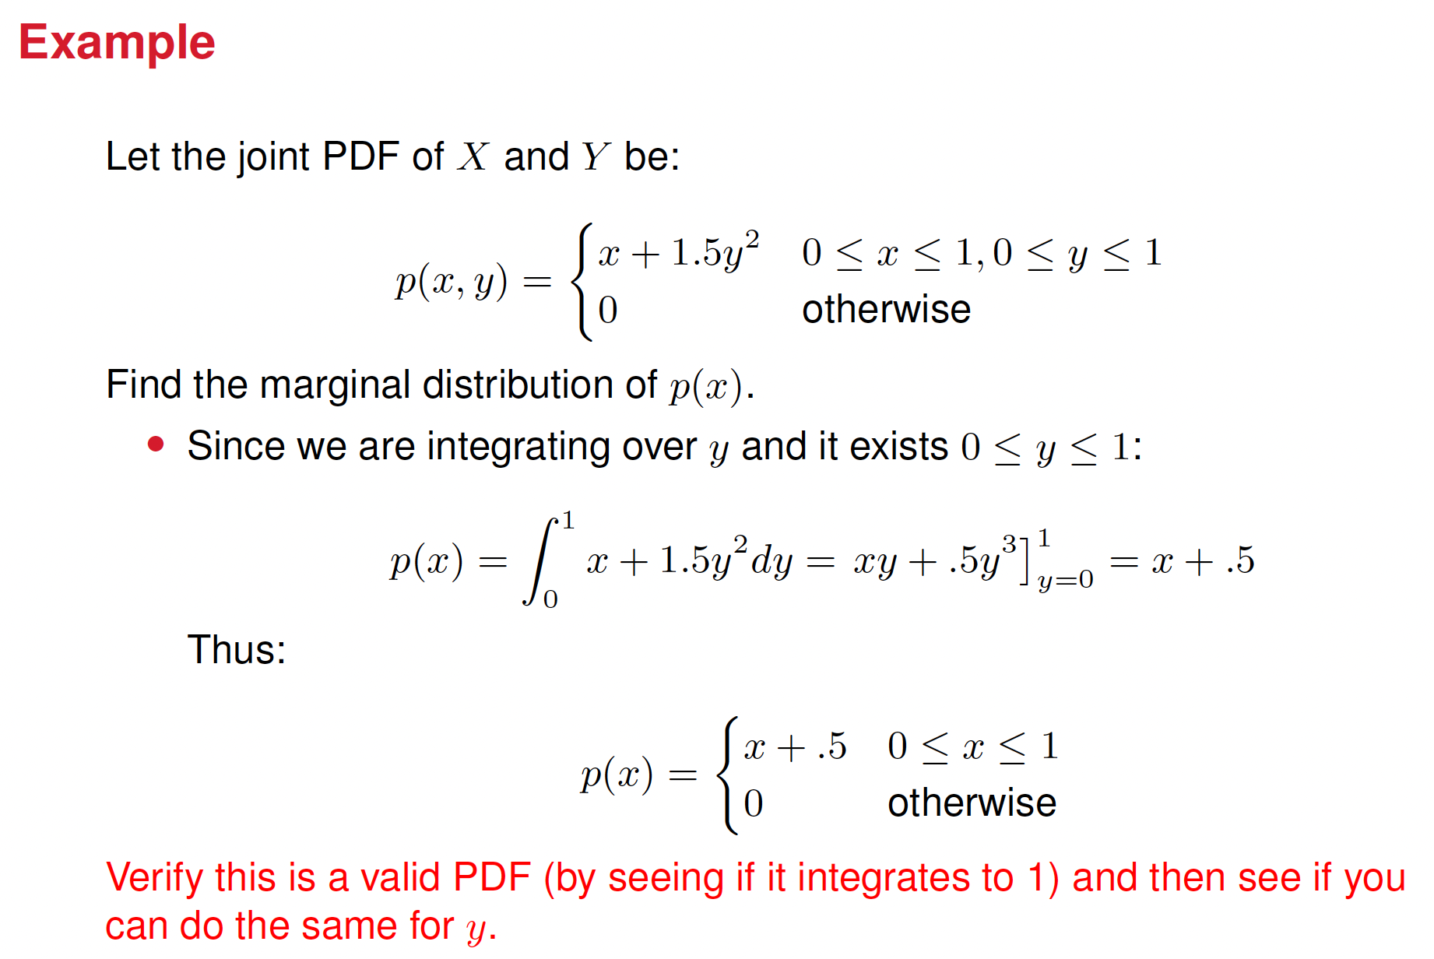

Slide 26
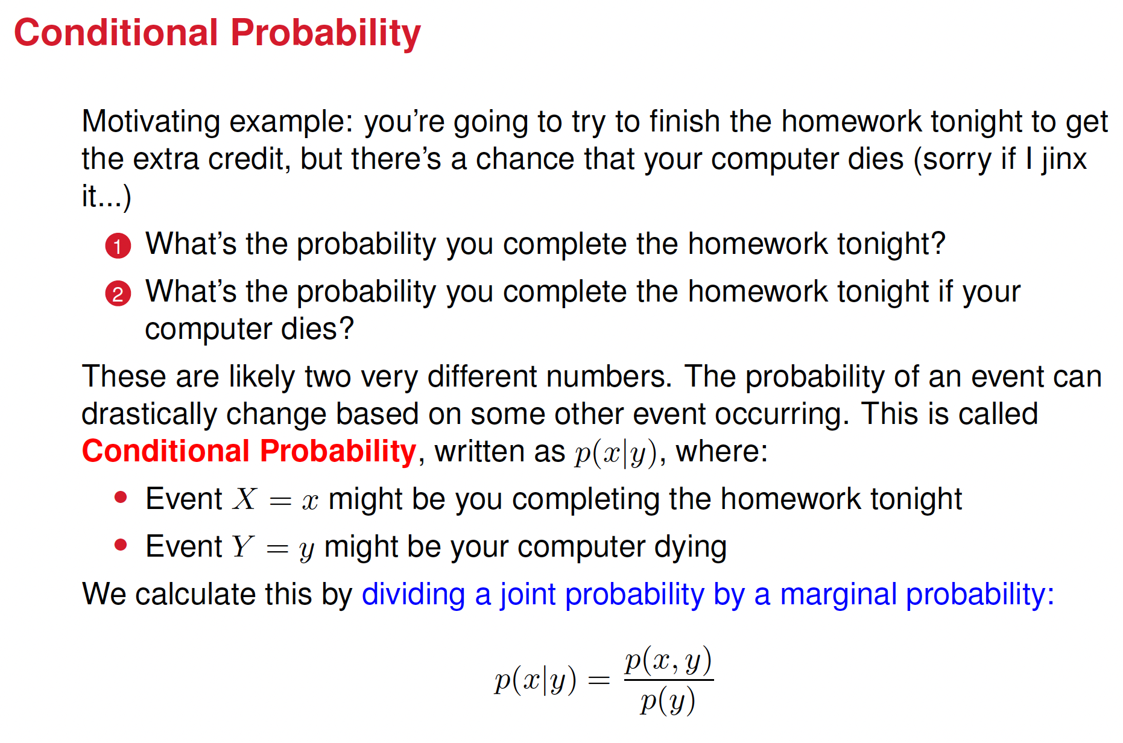

Slide 27
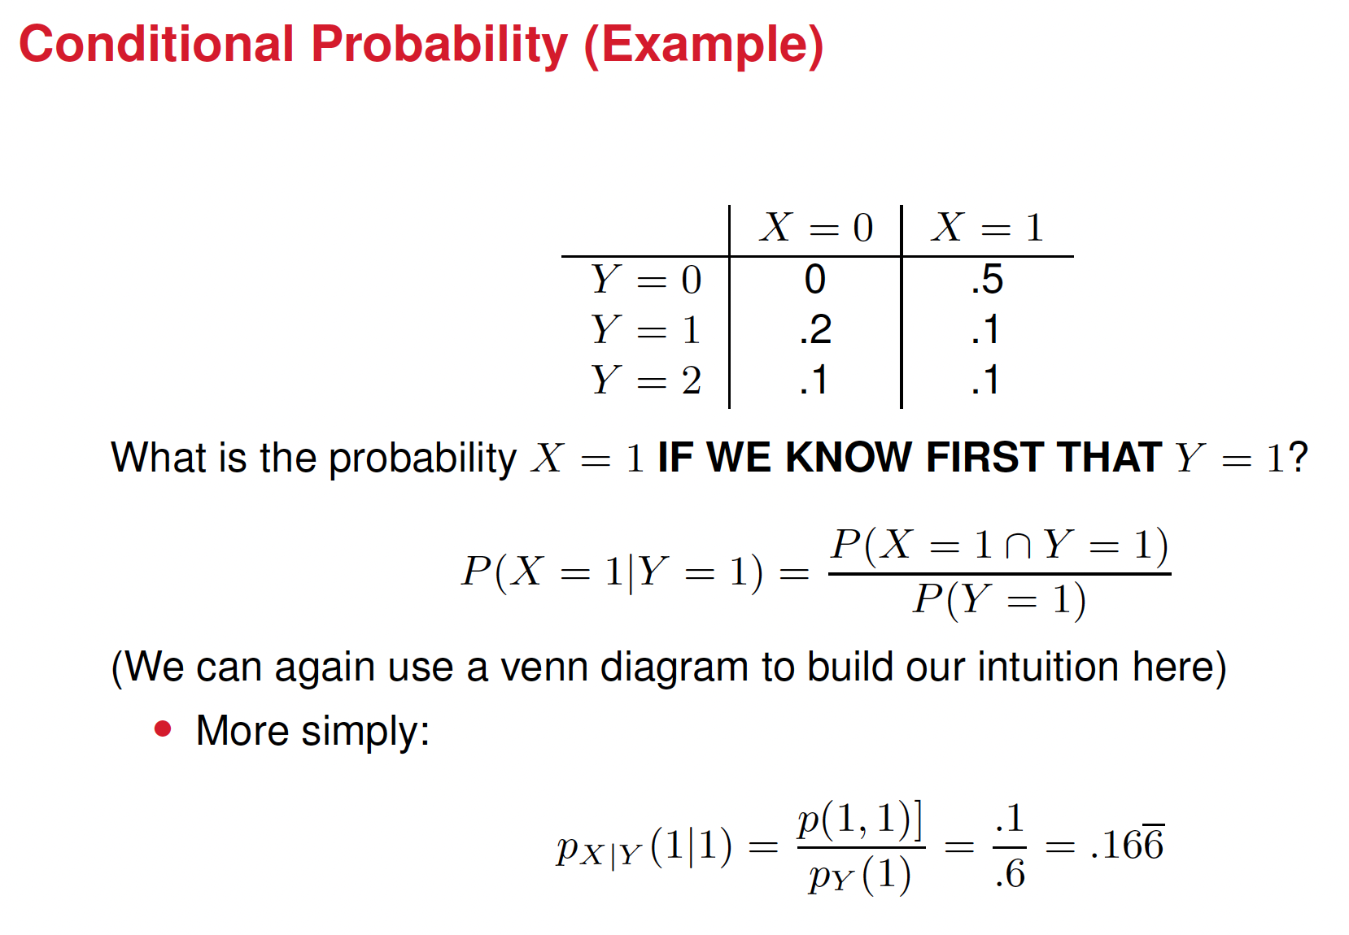
It’s 0.3!

Slide 28
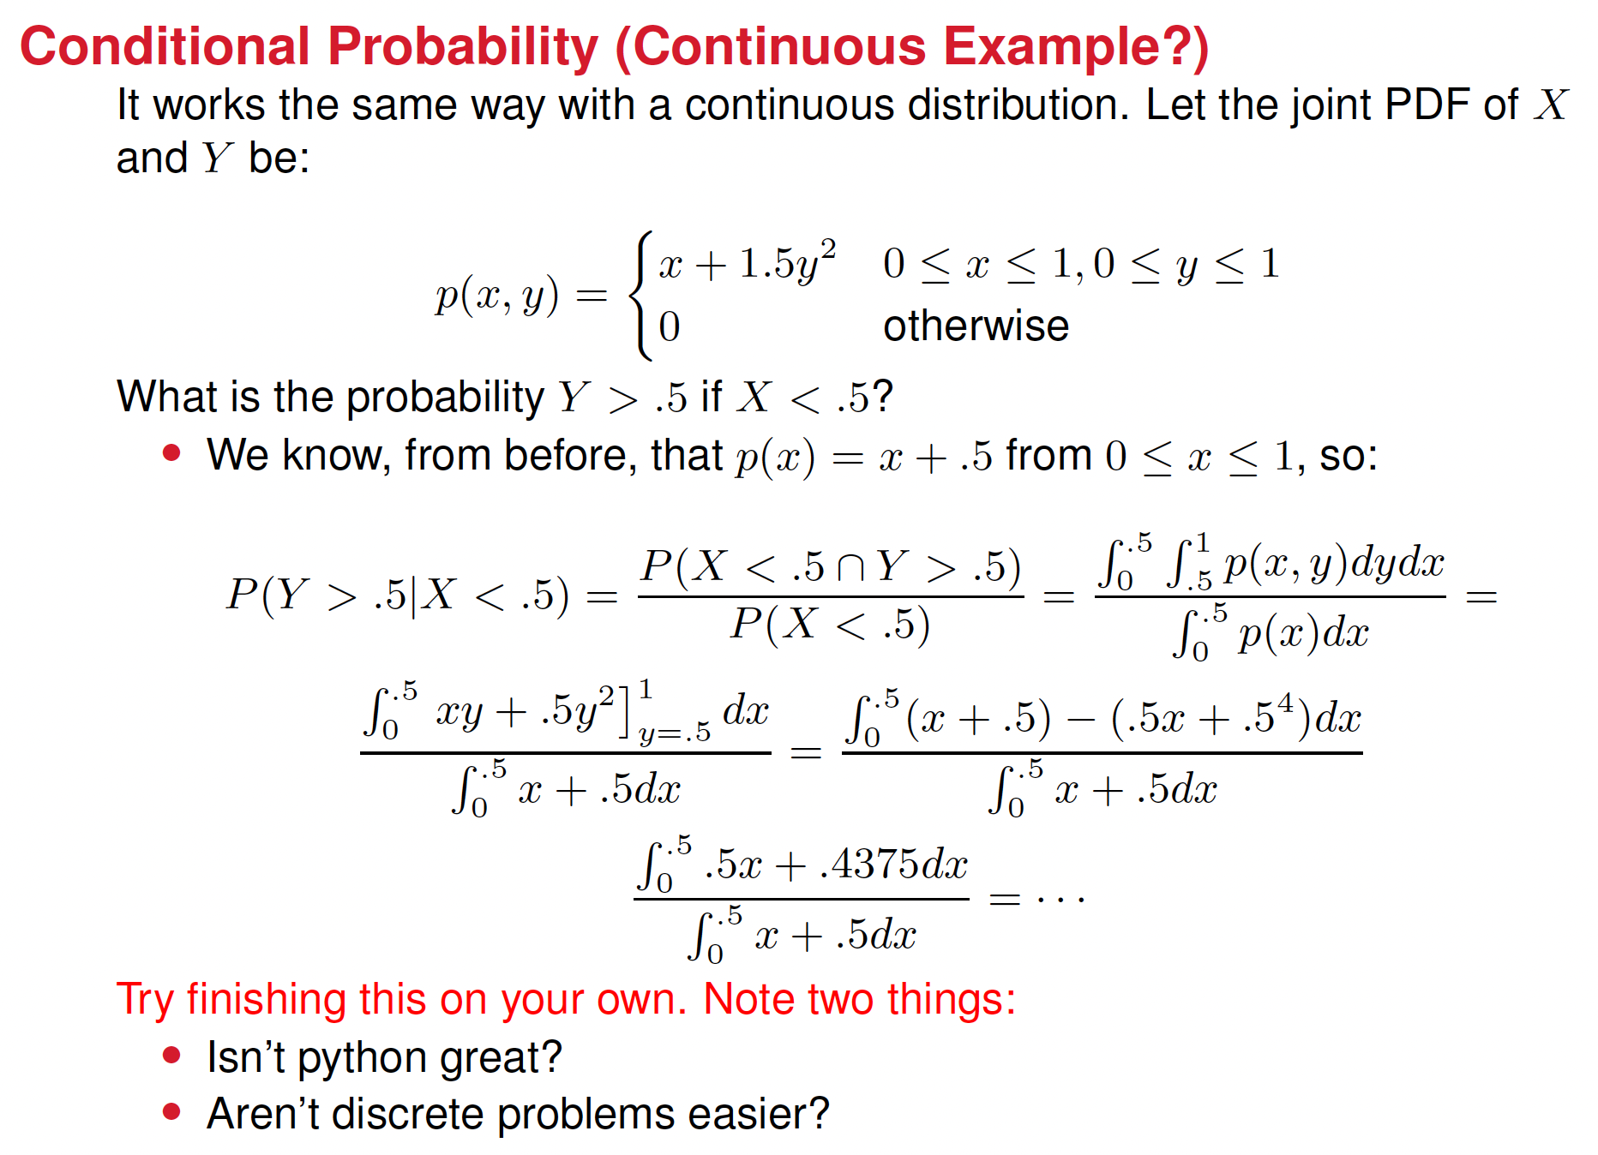


Slide 29
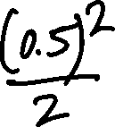


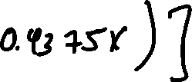
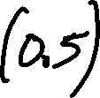








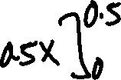





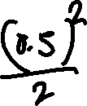





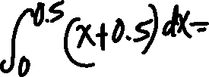


Slide 30
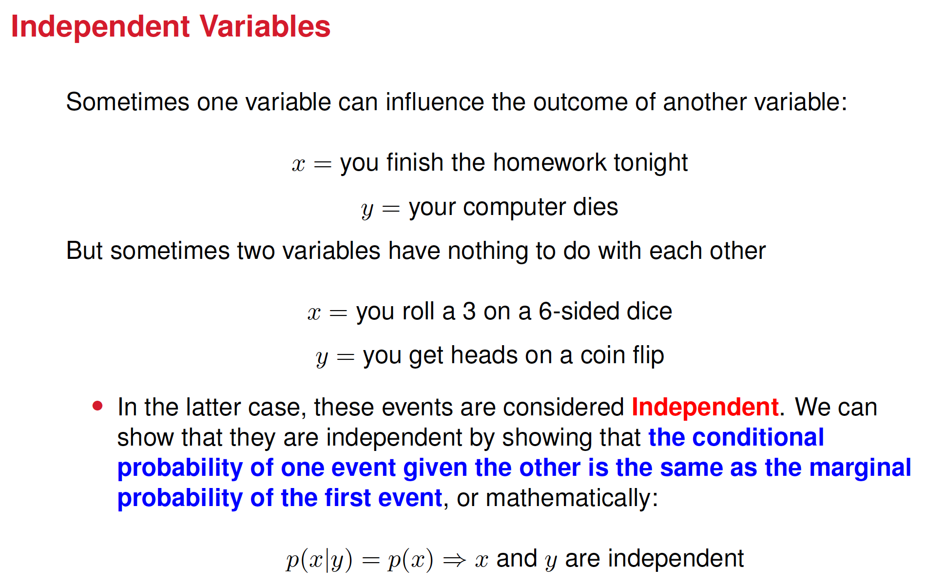

Slide 31
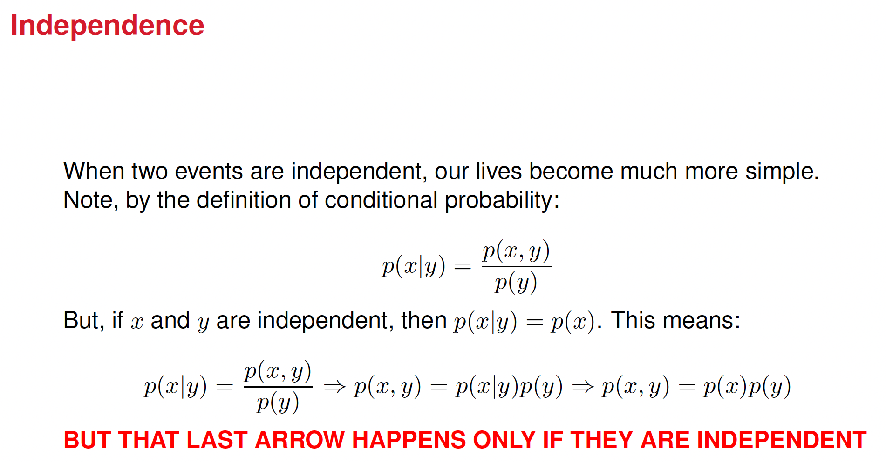

Slide 32
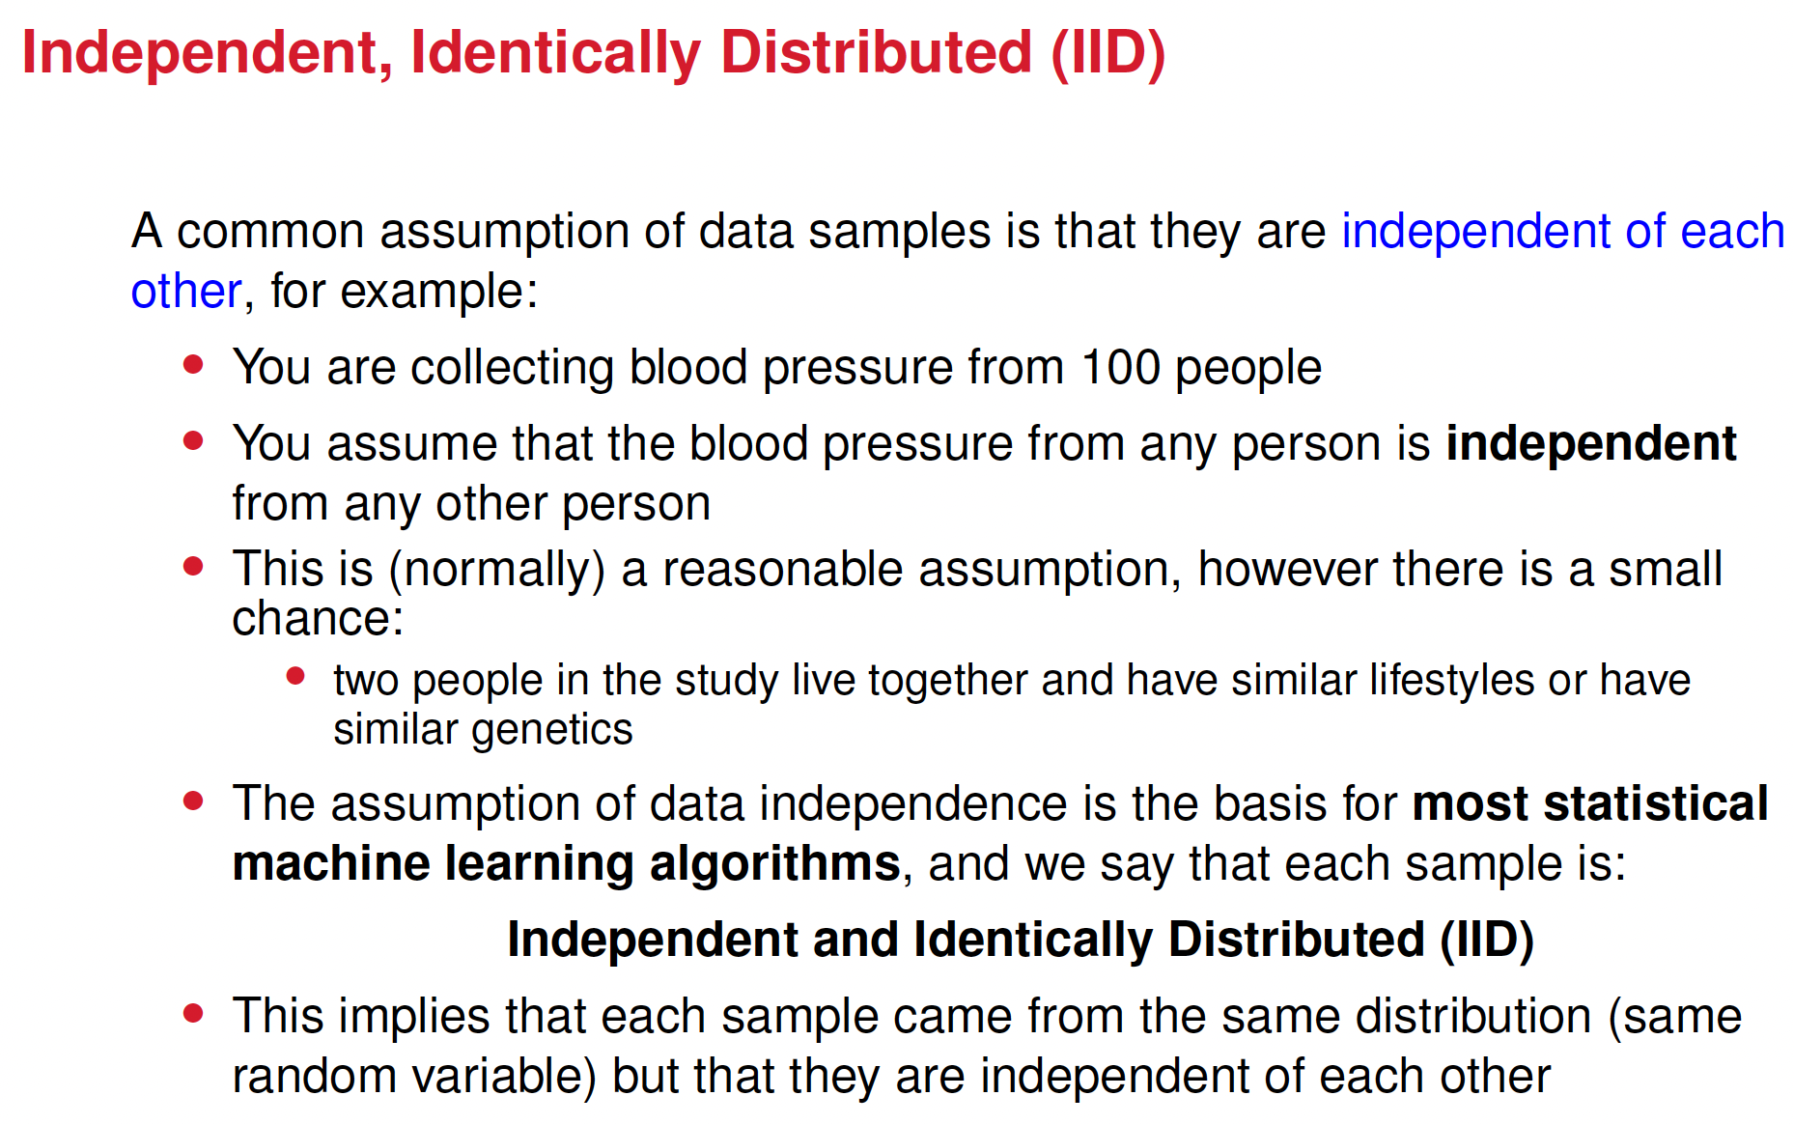

Slide 33
In Real Life
We often don’t know for sure what the probability function for a random variable is; we only have data that we can use to estimate it. There are many ways to do this:
Histograms
Maximum Likelihood Estimation
Kernel Density Estimation
Method of Moments
MAP Estimation
Bayesian Estimation
Variational Autoencoders
Generative Adversarial Networks (GANs)
Transformers
Flow models
Variational Inference
and many, many more
It would take an entire course (maybe DS 4420?) to cover all of this. We may talk about a few, but for now let’s just focus on the simplest one... histograms

Slide 34
Using Histograms
Check out the probability.ipynb file again to see how to create basic histograms in python. We can use these to estimate both PMFs and PDFs.
You’ll do this for a few different shaped histograms on HW3

